Slide 1
Seminar - validity
Mae4011 Principles of Measurement

Slide 2
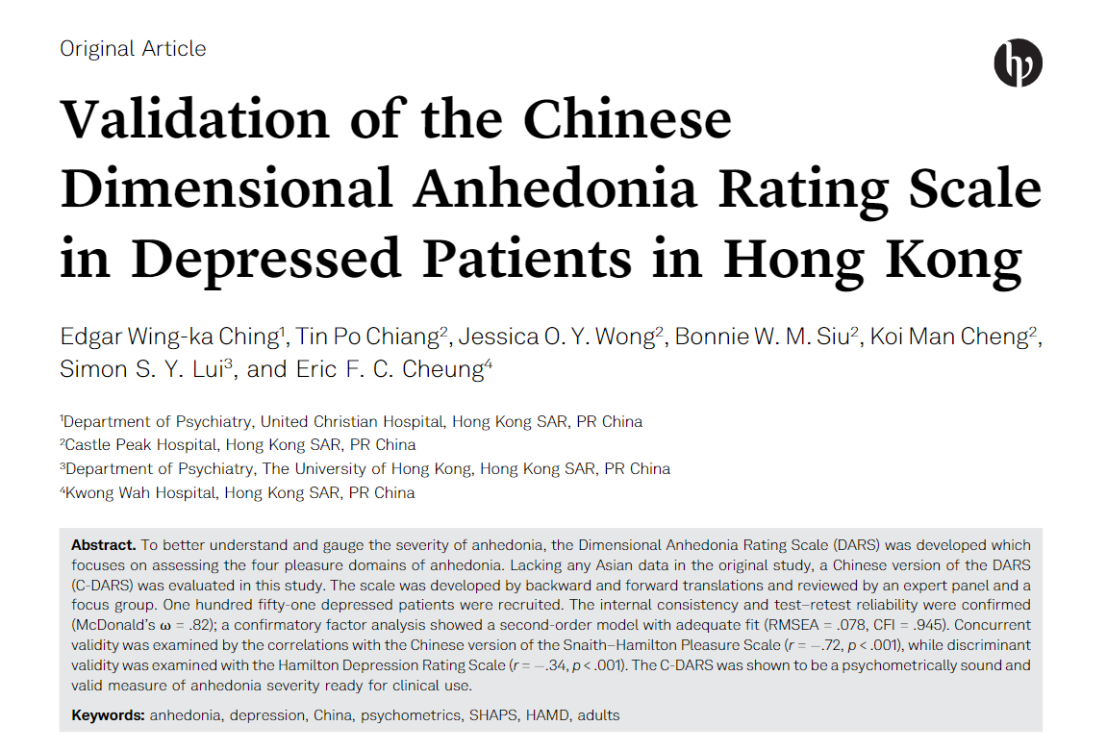
Validation of the C-DARS in Depressed Patients in Hong Kong (Edgar et al., 2021)
C-DARS= Chinese Dimensional Anhedonia Rating Scale
Self-report questionnaire
Anhedonia = the inability to experience pleasure (Ribot,1896)
DARS (Rizvi et al., 2015): the original study in English
C-DARS: 17 items, four components (Hobbies, Food and Drink, Social Activities, Sensory Experiences)
Implication: assess anhedonia severity in depressed patients, early identification -> treatment planning

Slide 3
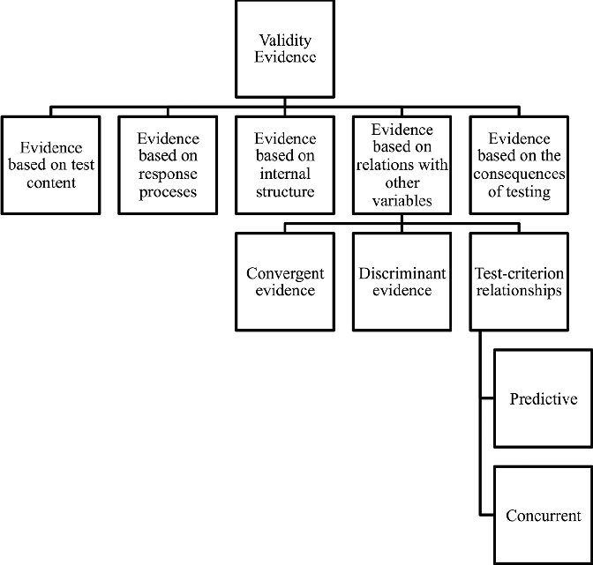
Validity evidence
Concurrent validity with Chinese version of the Snaith-Hamilton Pleasure Scale (r = -.72, p< .001)
Discriminant validity with Hamilton Depression Rating Scale (r = -.34, p< .001) + correlation between socio-demographic variables and C-DARS is very weak
Content validity: established after evaluation, modification of wordings
Categories of evidence used to argue for the validity of test score interpretations and uses (AERA, APA, and NCME, 2014).

Slide 4
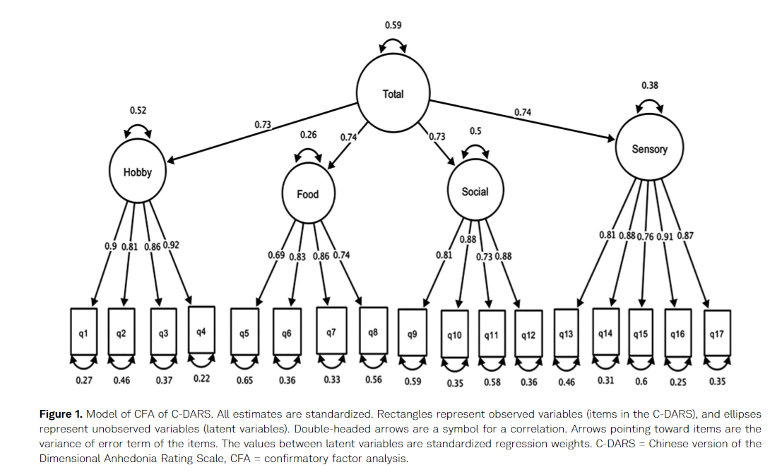
Validity evidence
Structural validity
CFA: - interfactor corr of subscales = moderate - corr between subscores and total score = high
=> confirming four-factor structure of the scale

Slide 5
Evaluation
Stable correlation coefficient? Sample size is below 250 (Schönbrodt & Perugini, 2013)
Convergent validity weaker for heterogeneous group -> more controlled cohort participants in this study
Interpretation of test scores unclear, should be made explicit in the conceptual framework (to decide which evidences are relevant)
Use of previous validation research
Future studies: predictive validity
In general: valid measure of anhedonia severity + for clinical use

